Slide 1



CS61
Series
Projects

Slide 2
CS61A:
Hog:
Implement a dice game simulator with strategies in Python
Cats:
Analyze typing speed and accuracy. Code in Python, connects to course run website with javascript.
Ants:
Plants versus zombies type game; use object oriented code to implement.

Slide 3
CS61B:
Project 0:
Implement Hangman game in Java with pattern aware guesser and challenging word picker.
Project 1:
Build Deque Data Types as a linked list and as a backing array. AND C+D to do.
Project 2:
Analyze Google NGrams for historical word frequency and semantic synonym and hyponym sets using Java tree structures.
Project 3:
2D Tile world generator with keyboard actions in Java.

Slide 4
CS61C:
Project 1:
Snek; a command line game of snake in C.
Project 2:
Classify Numerals; ML algorithm to classify handwritten digits in RISC-V
Project 3:
Build a CPU circuit that can handle RISC-V instructions. In Logisim circuit simulator.
Project 4:
Video Processing; applying convolutions to matrixes with focus on runtime. In C.

Slide 5
EECS 16A
Beginner Circuit Labs

Slide 6
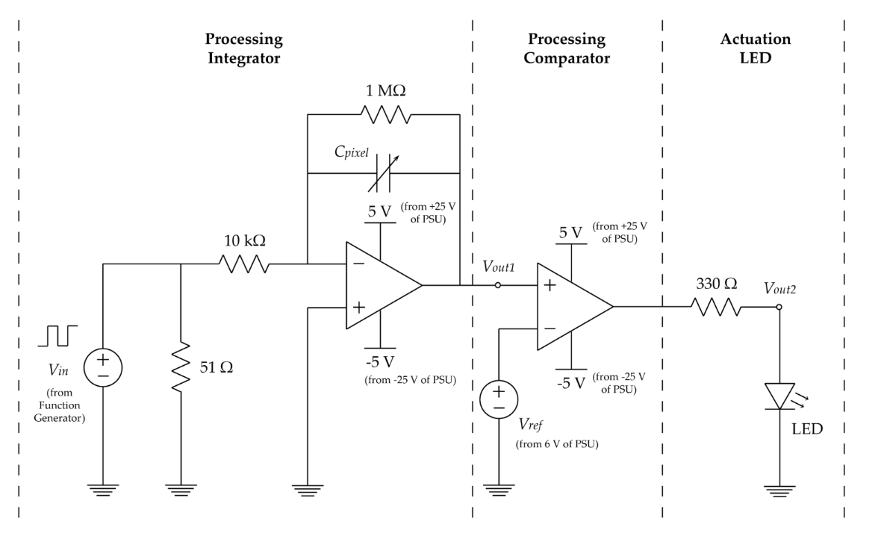
Imaging
Touchscreen
APS
Using masks to reconstruct an image using a single diode.
Creating 2D touchscreens using both resistors and capacitors.
Determining location in 3D space.

Slide 7
S1XT33N–The Voice Controlled Robot
16B Lab

Slide 8
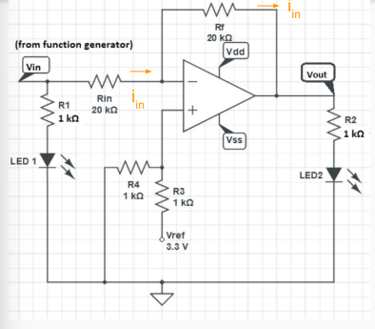
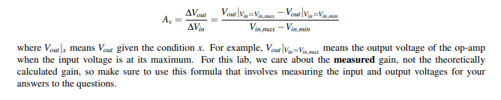
Lab 1 -Offset Inverting Amplifier
Note, due to issues with oscilloscope, Sonia recognised that we couldn’t get the actual readings for this circuit.
If one LED is on, The other is off, with a gradual slope in between.

